Slide 1
COMPUTER ORGANIZATION AND ASSEMBLY LANGUAGE (COAL CSC321)

Slide 2
INTRODUCTION TO IBM PC ASSEMBLY LANGUAGE

Slide 3
Assembly Language Syntax
An assembly language is an extremely low-level programming language that has a 1-to-1 correspondence to machine code the series of binary instructions which move values in and out of registers in a CPU (or other microprocessor).
Assembly language programs are translated into machine language instructions by an assembler, so they must be written to conform to the assembler's specifications.
An assembly language program consists of statements.
Statement 2. directive

Slide 4
RULES
Only one statement is written per line
Each statement is either an instruction or an assembler directive
instruction is translated into machine code
assembler directive instructs the assembler to perform some specific task, such as allocating memory space for a variable or creating a procedure

Slide 5
Program Statement
The general format for an assembly language program statement is as follows:
name operation operand’(s) comment
Examples:
An example of an instruction is,
START: MOV CX,5 ; initialize counter
An example of an assembler directive is,
MAIN PROC

Slide 6
Name Field
This field is used for:
instruction label: if present, a label must be followed by a colon (:)
procedure names
variable names.
Note: The assembler translates names into memory addresses.

Slide 7
Name Field Rules:
Assembly language imposes some rules on how names are assigned to labels, variables, procedures and macros. It is the assembler's function to translate those names into memory addresses.
Assembler translates names into memory addresses.
Names can be from 1 to 31 characters long: (letters, digits, and special characters: ?, ., _, $, @, %)
Embedded blanks are not allowed, names may not begin with a digit,
A name should not begin with a digit
A name may begin with a letter or a special character
If a period (.) is used, it must be the first character
Names are not case sensitive

Slide 8
4.1.1 Name Field
Examples:
Legal Names Illegal Names
COUNTER1 2ABC (contains a blank )
@CHARACTER TWO WORDS (begins with a digit)
$500 A45.26 (. not first character)
SUM_OF_DIGITS YOU&ME (contains an illegal character)
.TEST
DONE?

Slide 9
4.1.2 Operation Field
For an instruction
This field consists of a symbolic operation code, known as op-code
The opcode describes the operation’s function ( MOV, ADD, SUB. )
Symbolic op-codes are translated into machine language opcode.

Slide 10
4.1.2 Operation Field
For an assembler directive
This field consists of a pseudo-operation code (pseudo-op)
Pseudo-ops are not translated into machine code;
pseudo-ops tell assembler to do something i.e.(SUM, PROC, NEAR) For example, the PROC pseudo-op is used to create a procedure.

Slide 11
4.1.3 Operand Field
1. For an instruction,
This field specifies data to be acted on. It may have one, two or no operands at all.
Examples of instructions with different operand fields
NOP ; Instruction with no operand field
INC AX ; Instruction with one operand field
ADD AX, 2 ; Instruction with two operand field
If 2 operands: the first is destination [It is the register or memory location where the result is stored (note: some instructions don't store the result)]., the second is the source operand
2. For an assembler directive,
the operand field usually contains more information about the directive.

Slide 12
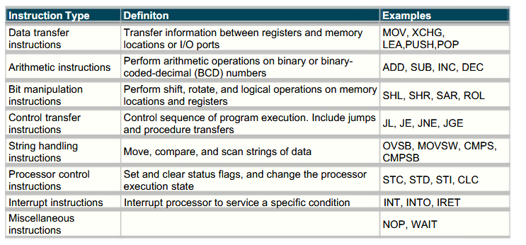
instructions for the 8086 processor These instructions may be classified into different classes. The following table summarizes the different classes of instructions, together with examples of each class.

Slide 13
4.1.4 Comment Field
A semicolon marks the beginning of a comment
A semicolon in the beginning of a line makes it all a comment line
Good programming practice dictates the use of a comment on almost every line.
Do not say something that is obvious. Put instruction in context of program
Example,
MOV CX, 0 ; Move 0 to CX. (This is not a good comment.)
MOV CX, 0 ; CX counts terms, initially set to 0. (This is a good comment.)

Slide 14
Program Data
The processor operates only on binary data.
Thus, the assembler must translate all data representation into binary numbers.
However, in an assembly language program we may express data as binary, decimal, or hex numbers, and even as characters.
Numbers
A binary number is written as a bit string followed by the letter “B“ or "b"; for example, 1010B
A decimal number is a string of decimal digits, ending with an optional "D" or "d".
A hex number must begin with a decimal digit and end with the letter "H" or "h"; for example, 0ABCH
NOTE:
(the reason for this is that the assembler would be unable to tell whether a symbol such as "ABCH" represents the variable name "ABCH" or the hex number ABC).

Slide 15
Numbers
Examples:
Use a radix symbol (suffix) to select binary, octal, decimal, or hexadecimal
number type
1010 decimal
1010B binary
-2134D decimal
ABFFH illegal
0ABFFH hex
1BHH illegal
1BFFH hex
1,23 illegal
Signed numbers represented using 2’s complement.

Slide 16
Characters
Characters and character strings must be enclosed in single or double quotes; ‘A' , “hello“.
Assembler translates characters to their ASCII code
( so there is no difference between using “A” and 41H)

Slide 17
Variables
Each variable has a type and assigned a memory address.
Data-defining pseudo-ops
DB define byte
DW define word
DD define double word (two consecutive words)
DQ define quad word (four consecutive words)
DT define ten bytes (five consecutive words)
Each pseudo-op can be used to define one or more data items of given type.

Slide 18
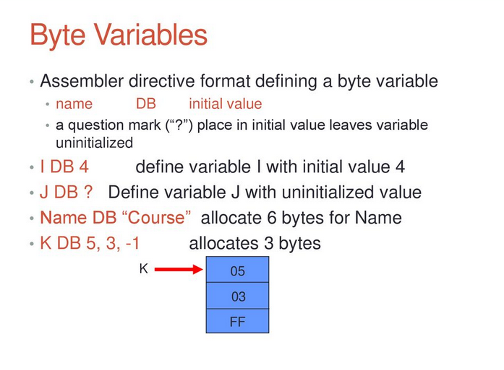
Byte variables

Slide 19
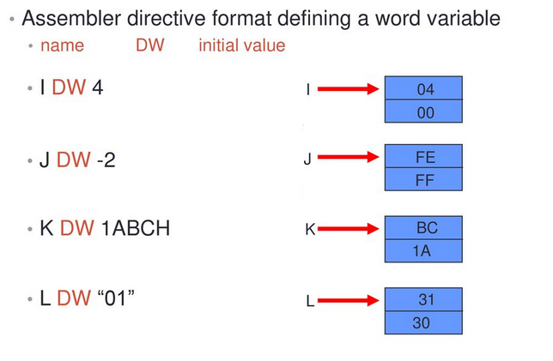
Word variables ( 2 bytes)

Slide 20
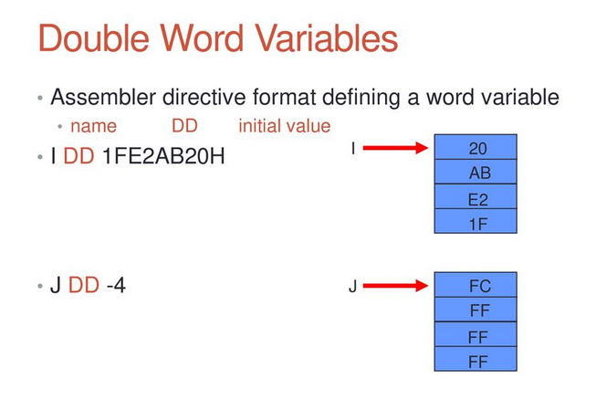

Slide 21
Array Examples
In assembly language, an array is just a sequence of memory bytes or words. for example, to define a three-byte array called B_ARRAY, whose initial values are 10h, 20h, and 30h, we can write,
B_ARRAY DB 10, 25, 20
If array starts at offset address 0200h, it will look like this:
Symbol Address Contents
B-ARRAY 0200H 10
B-ARRAY+1 0200H+1 25
B-ARRAY+2 0200H+2 20

Slide 22
Arrays in Assembly Language
In assembly language, an array is just a sequence of memory bytes or words.
There are two ways to define an array in assembly language.
Initialized Lists
An initialized array is defined in the same way as a scalar variable, but with multiple initial values.
scores: .word 100, 78, 63, 88, 52, 91, 75
Uninitialized Memory Blocks
Uninitialized arrays are defined using the .space directive.
scores: .space 400
Caution
The .space directive allocates the specified number of bytes. Specifying the desired number of array elements is a common mistake.

Slide 23
Array Examples
W_ARRAY DW 0FFFFh, 789Ah, 0BCDEh
If array starts at offset address 0100h, it will look like this:
(To access an array in assembly language, we use a pointer. A pointer is simply a register or variable that contains a memory address.
The value in the pointer is computed as shown in the previous sections by adding the base address of the array and the offset of the desired element)
Symbol Address Contents
W_ARRAY 0100H FFFFH
W_ARRAY+2 0102H 789AH
W_ARRAY+4 0104H BCDEH

Slide 24
Character strings
Examples:
1)
LETTERS DB ‘AaBCbc‘
Is equivalent to
LETTERS DB 41H,61H,42H,43H,62H,63H
2)
MSG DB ‘ABC‘,0AH,0DH,‘$‘
Is equivalent to
MSG DB 41H,42H,43H,0AH,0DH,24H

Slide 25
QUESTION Show how character string “RG 2z” is stored in memory starting at address 0
SOLUTION:-
Address | Character | ASCII Code (HEX) | ASCII Code (Binary) 18 [Memory Contents]
0 | R | 52 | 0101 0010
1 | G | 47 | 0100 0111
2 | Space | 20 | 0010 0000
3 | 2 | 32 | 0011 0010
4 | z | 7A | 0111 1010

Slide 26
Constant Declaration
In an assembly language program, constants are defined through the use of the EQU (Equates) directive.
Syntax:
Name EQU constant
The EQU directive is used to assign a name to a constant.
Use of constant names makes an assembly language easier to understand.
No memory is allocated for a constant.
The symbol on the right of EQU cab also be a string

Slide 27
Constant Declaration
Examples:
1)
LF EQU 0AH ; LF can be used in place of 0Ah
MOV DL LF
MOV DL 0AH
2)
PMT EQU ‘TYPE YOUR NAME‘ ;
instead of
MSG DB ‘TYPE YOUR NAME‘
We can use
MSG DB PMT
Have the same machine code

Slide 28
BASIC INSTRUCTIONS
MOV and XCHG

Slide 29
MOV instruction
Is used to transfer data :
between registers,
between a register & a memory location.
Or
To move a number directly into a register or memory location.

Slide 30
Syntax
MOV destination , source
Example:
MOV AX , WORD1
This reads “ Move WORD1 to AX “
The contents of register AX are replaced by the contents of the memory location WORD1.

Slide 31
Mov AX , WORD1
Before
After
0006
0008
AX
AX
0008
0008
WORD1
WORD1

Slide 32
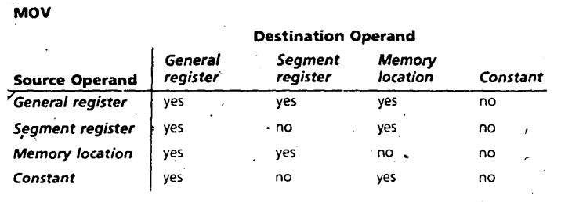
MOV AH , ‘A’
This is a move of the 041h ( the ASCII code of “A” ) into register AH.
The previous value of AH is overwritten ( replaced by new value )

Slide 33
XCHG instruction
(Exchange) operation is used to exchange
the contents of
two registers, or
a register and a memory location

Slide 34
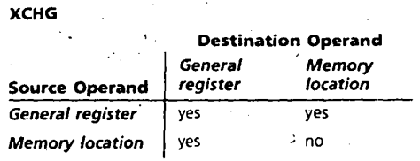
Syntax
XCHG destination , source

Slide 35
Example
XCHG AH , BL
This instruction swaps the contents of AH and BL.

Slide 36
XCHG AH , BL
Before
After
1A
00
05
00
AH AL
AH AL
00
05
00
1A
BH BL
BH BL

Slide 37
Example
XCHG AX , WORD1
This swaps the contents of AX and memory location WORD1.

Slide 38
Restrictions on MOV
Example :
ILLEGAL : MOV WORD1 , WORD2
LEGAL:
MOV AX , WORD2
MOV WORD1 , AX

Slide 39
ADD & SUB
Are used to add & subtract the contents of
two registers,
a register & memory location , or
a register and a number
memory location and a number.

Slide 40
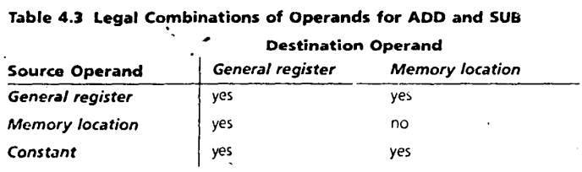
Syntax
ADD destination , source
SUB destination , source

Slide 41
Example
ADD WORD1 , AX
This instruction , “ Add AX to WORD1 “ , causes the contents of AX & memory word WORD1 to be added, and the sum is stored in WORD1. AX is unchanged.

Slide 42
Example
SUB AX , DX
This instruction , “ Subtract DX from AX “ , the value of DX is subtracted from the value of AX , with the difference being stored in AX. DX is unchanged.

Slide 43
Example
ADD BL , 5
This is an addition of the number 5 to the contents of register BL.

Slide 44
ILLEGAL
ADD BYTE1 , BYTE2
Solution :
move BYTE2 to a register before adding
MOV AL , BYTE2 ; AL gets BYTE2
ADD BYTE1 , AL ; add it to BYTE1

Slide 45
INC ( increment )
Is used to add 1 to the contents of a
Register or
Memory location

Slide 46
DEC ( decrement )
Is used to subtract 1 from the contents of a
Register or
Memory location

Slide 47
Syntax
INC destination
DEC destination

Slide 48
Example
INC WORD1
adds 1 to the contents of WORD1

Slide 49
Example
DEC BYTE1
subtracts 1 to the variable BYTE1

Slide 50
NEG (negate)
Is used to negate the contents of the destination.
It does this by replacing the contents by its two’s complement.

Slide 51
Syntax
NEG destination
The destination may be a
register or
memory location.

Slide 52
NEG BX
Before
After
0002
FFFE
BX
BX

Slide 53
Translation of HLL to Assembly Language
Statement Translation
B = A MOV AX , A ; moves A into AX
MOV B , AX ; and then into B
WHY
Because direct memory – memory move is illegal we must move the contents of A into a register before moving it to B.

Slide 54
Translation of HLL to Assembly Language
Statement Translation
A = 5 – A MOV AX , 5 ; put 5 in AX
SUB AX , A ; AX…. 5 – A
MOV A , AX ; put it in A

Slide 55
Translation of HLL to Assembly Language
Statement Translation
A = B – 2 * A MOV AX , B ; AX has B
SUB AX , A ; AX has B – A SUB AX , A ; AX has B – 2 * A
MOV A , AX ; move results to B

Slide 56
Program Structure
Machine language programs consist of :
Codes,
Data, and
Stack.
Each part occupies a memory segment. They are structured as program segments. Each program segment is translated into a memory segment by the assembler.

Slide 57
Memory Models
The size of the code & data a program can have is determined by specifying a memory model using the . MODEL directive.

Slide 58
Syntax
. MODEL memory_mode1
LARGE
SMALL
MEDUIM
COMPACT
Code in more than one segment
Data in more than one segment
No array larger than 64K bytes.
Code in one segment
Data in one segment
Code in more than one segment
Data in one segment
Code in one segment
Data in more than one segment

Slide 59
Unless there is a lot of code or data, the appropriate model is SMALL.
. MODEL directive should come before any segment definition.

Slide 60
Data Segment
A program’s data segment contains all the variable definitions. Constant definitions are made here as well, but they may be placed elsewhere in the program since no memory allocation is involved.
We use the . DATA directive followed by variable & constant declarations.
Variable addresses are computed as offsets from the start of this segment

Slide 61
Example
.DATA
WORD1 DW 2
WORD2 DW 5
MSG DB ‘ This is a message ‘
MASK EQU 10010010B

Slide 62
Stack Segment
Used to set aside storage for the stack
Stack addresses are computed as offsets into this segment
Use: .stack followed by a value that indicates the size of the stack

Slide 63
Declaration Syntax
.STACK size
An optional number that specifies the stack area size in bytes.

Slide 64
Example
.STACK 100 H
Sets aside 100h bytes for the stack area ( a reasonable size for most applications ) .
If size is omitted , 1 KB is set aside for the stack area.

Slide 65
Code Segment
It contains a program’s instructions.

Slide 66
Syntax
.CODE name
Optional name for the segment
there is no need for a name in a SMALL program
Why??
The assembler will generate an error

Slide 67
Inside the code segment
Instructions are organized as procedures.
The simplest procedure definition is :
name PROC
; body of the procedure
name ENDP
name is the name of the procedure, PROC and ENDP are pseudo-op that delineate the procedure

Slide 68
Example
.CODE
MAIN PROC
; main procedure body
MAIN ENDP
; other procedures go here

Slide 69
Program Structure
A program has always the following general structure:
.model small ;Select a memory model
.stack 100h ;Define the stack size
.data
; Variable and array declarations ; Declare variables at this level
.code
main proc
; Write the program main code at this level
main endp
;Other Procedures
; Always organize your program into procedures
end main ; To mark the end of the source file

